Slide 1
Population Geography
Exploring Patterns, Dynamics, and Impacts of Population

Slide 2
A branch of geography that studies:
Distribution of people across the Earth
Demographic characteristics like age, gender, and ethnicity.
Population changes over time.
Importance:
Helps in urban planning, resource allocation, and understanding social dynamics.

Slide 3
Key Concepts in Population Geography
Population Distribution: Where people live.
Population Density: People per unit area.
Population Growth: Changes in population size over time.
Demographic Transition Model (DTM): Explains population changes over different development stages.

Slide 4
Factors Influencing Population Distribution
Physical Factors
Human Factors
Climate
Relief and topography
Soil fertility
Economic opportunities
Political stability
Infrastructure and technology

Slide 5
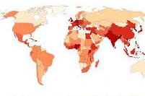
Population Density Patterns
High-Density Regions: Urban areas (e.g., Tokyo, Dhaka).
Low-Density Regions: Deserts, polar regions, and mountainous areas.

Slide 6
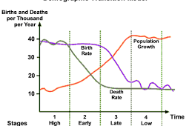
Demographic Transition Model
Stages of DTM:
Stage 1: High birth and death rates.
Stage 2: Declining death rates.
Stage 3: Declining birth rates.
Stage 4: Low birth and death rates.
Stage 5 (possible): Population decline.

Slide 7
Challenges in Population Geography
Overpopulation: Strain on resources and services.
Aging Population: Social and economic challenges.
Urbanization: Infrastructure and environmental impacts.
Migration Issues: Refugee crises and border policies.

Slide 8
Applications of Population Geography
Urban Planning: Designing efficient cities.
Disaster Management: Understanding vulnerable populations.
Resource Allocation: Equitable distribution of resources.
Sustainable Development Goals (SDGs): Achieving global targets for population-related challenges.

Slide 9
The END

